Slide 1
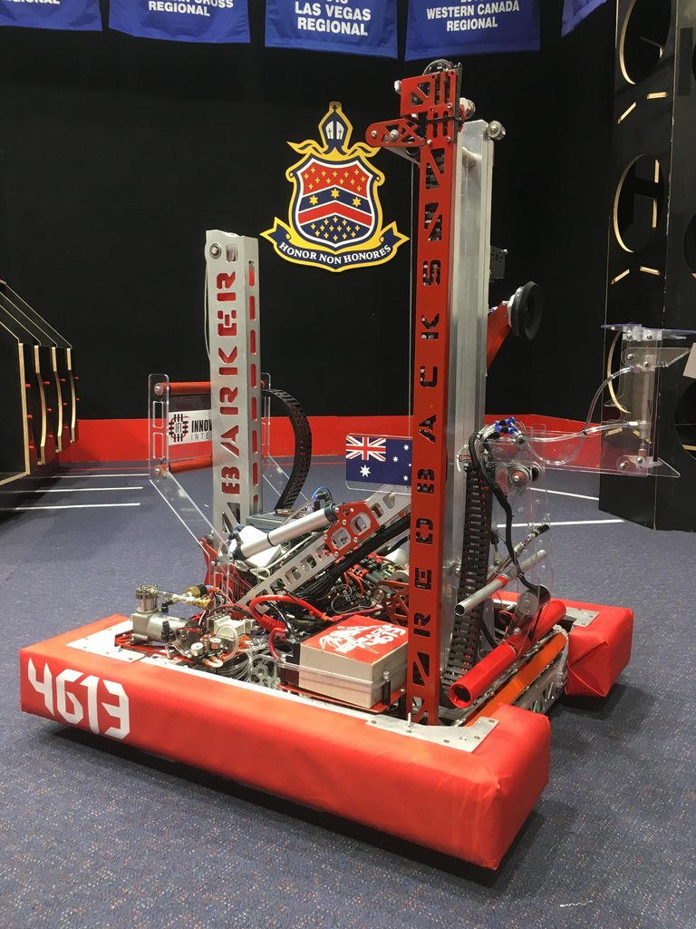

Iterative Robot Implementations
Overall Topic: Hardware
Basic Workshop 1.3

Slide 2

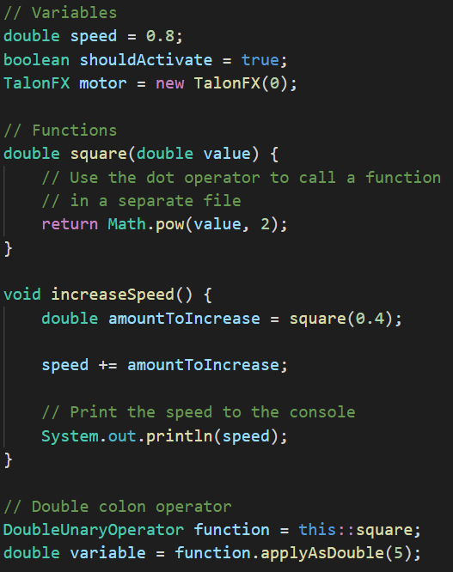
What do we know so far?
Variables
‘Boxes’ that hold data of a specified type
Can be re-assigned to hold a new value
Functions
Reusable code to do something
Take input parameters and may return an output
Dot operator
Reference variables in other files or complex types
Call functions in other files or complex types
Double colon operator
Reference a function without calling it

Slide 3


Code libraries & Arachne
Robot code is built on top of existing code libraries.
WPILib is used by all teams
Hardware manufacturers supply libraries for their devices
In addition, we use Arachne, a library we’ve built up since 2014.
Similar structure to WPILib
Gives us extra features and increased control over operation

Slide 4
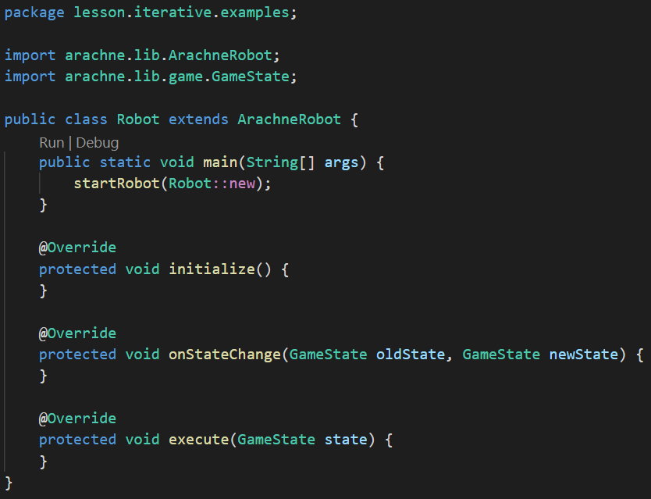
The robot template
All 4613 robot projects start from this template.
initialize
Called once on robot startup
onStateChange
Called when robot state changes
States: Disabled, Auto, Teleop
execute
Runs repeatedly

Slide 5
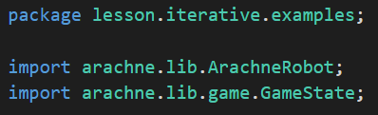
Packages and imports
What are packages?
Folders containing code files
Each folder should be a single lowercase word
Folders are separated by dots
Imports
Required for each separate file referenced from another package
Have form import package.File
Will be created automatically by most editors

Slide 6
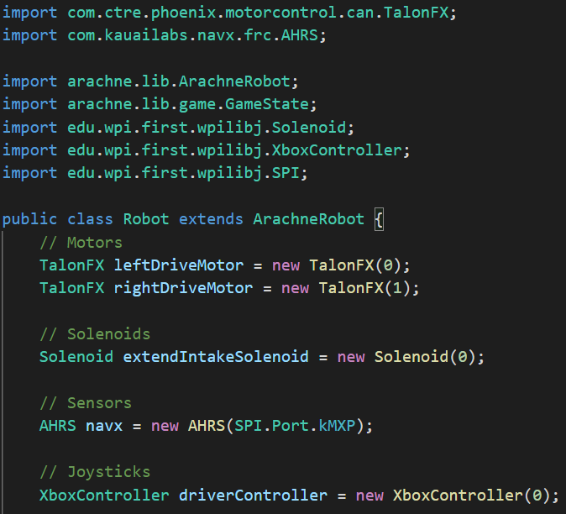
Creating I/O objects
The first step is to create variables for all inputs and outputs:
Motors
TalonFX, TalonSRX, VictorSPX, SparkMax
Solenoids
Solenoid, DoubleSolenoid
Sensors
Joysticks

Slide 7
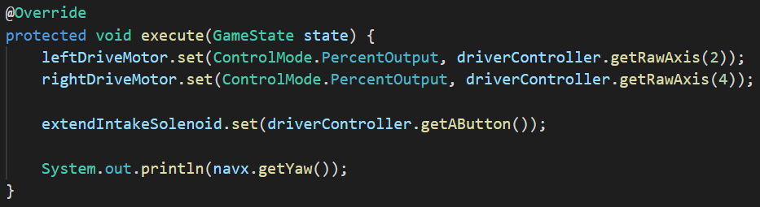
Basic execution
Inside execute() we can
Take sensor and controller inputs
Change motor and solenoid outputs
Do any other processing required each robot loop

Slide 8
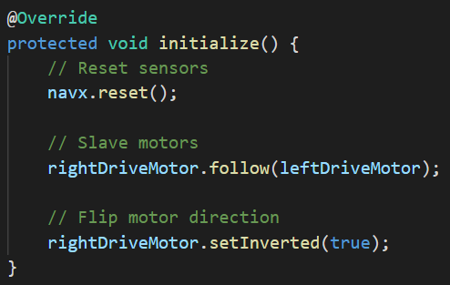
initialize()
Inside initialize() we can
Calibrate and set initial sensor values
Slave motor controllers
Flip motor directions
Do any other initial setup on robot load

Slide 9
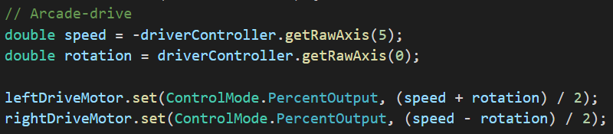
Setting up arcade-drive controls
Arcade-drive is a different control scheme for the robot’s drivetrain
The joystick’s Y-axis controls speed
The joystick’s X-axis controls rotation

